Slide 1
Guide to Meal prepping
Erin Keegan’s Personal Training Clients

Slide 2
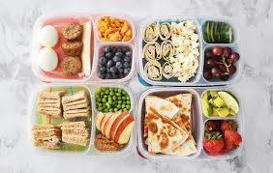

What is it?
To put it simply, meal prepping is preparing meals ahead of time
Usually using healthier, unprocessed ingredients

Slide 3
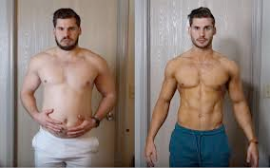
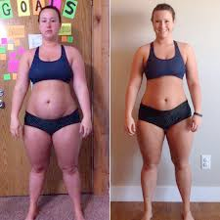
establish goals
It is important to acknowledge why you're meal prepping in the beginning to keep you motivated…
  Weight loss
  Increase muscle
  Free up time
  Save money

Slide 4
Why is it effective?
Saves you tons of time
Ensures you choose nutrient rich foods over junk foods
Helps with portion control

Slide 5
pick a day
Many use Sunday to prepare their meals
In the beginning, don’t try to prepare meals for the whole week at once
  No more than 3 meals at once
The use of a calendar out your meals for the week

Slide 6
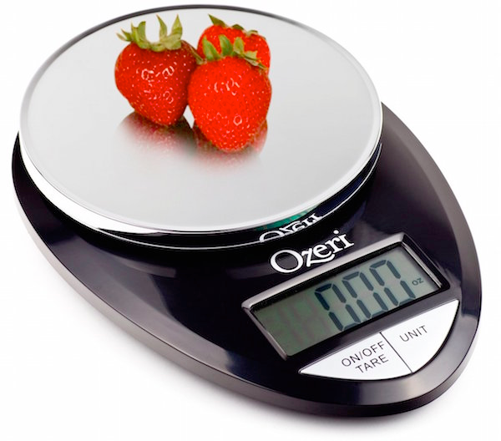
pick the meals
Pick which meals you want to prepare; breakfast, lunch, or dinner
Pick the recipes you want to follow
Try to follow specific macronutrient goals
  Proteins Fats Carbs
You may use a kitchen scale to figure out portion sizes

Slide 7
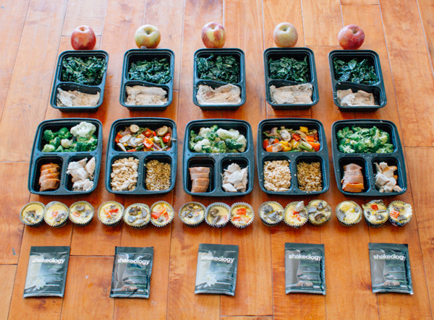
use proper containers
Containers with dividers are IMPORTANT
Avoids cross contamination
Air tight for fresher tasting foods
Clear so you can easily see what foods are inside

Slide 8
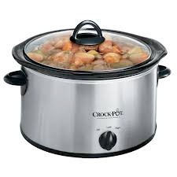
Helpful hints
Utilize the crockpot
Chicken can be cooked in endless number of ways and is easy to freeze
Fruits and salads are a quick and easy way to start

Slide 9
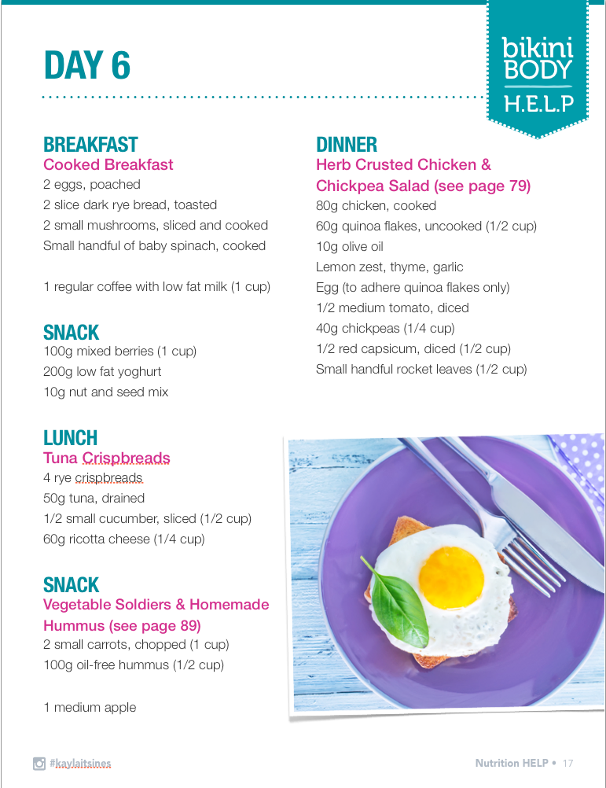

Slide 10
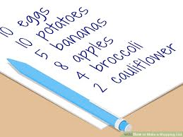
shopping
Plan out a schedule
2-3 days before prep day
Create list of meals, as well as ingredients needed
  This stops you from impulse buys

Slide 11
Citations
https://www.google.com/search?q=meal+prepping&source=lnms&tbm=isch&sa=X&ved=0ahUKEwjlqPWDgNXdAhVQrlkKHb9bC4oQ_AUIDigB&biw=1411&bih=728#imgrc=841kd3UzbVeOnM:
https://www.google.com/search?biw=1411&bih=728&tbm=isch&sa=1&ei=5o6pW4ifNIny5gKwqqnIDQ&q=fitness+transformations&oq=fitness+transformations&gs_l=img.3..0l4j0i5i30l6.46051.54527..55106...0.0..0.267.2598.15j4j4......0....1..gws-wiz-img.......0i67.3tKOF89edyk#imgrc=-yUdG5geGbZmlM:
https://www.google.com/search?biw=1411&bih=728&tbm=isch&sa=1&ei=JI-pW_z3GIjz5gLn0oJw&q=food+scales&oq=food+scales&gs_l=img.3..0l3j0i5i30l4j0i8i30l3.138318.141712..142201...0.0..0.290.1898.4j1j6......0....1..gws-wiz-img.......0i67.YeEkshvT-08#imgrc=pbmbdwXM673RvM:
https://www.google.com/search?biw=1411&bih=728&tbm=isch&sa=1&ei=1I-pW4z0OLKc5wK85JjABw&q=bikini+body+help+day+6&oq=bikini+body+help+day+6&gs_l=img.3...49516.55259..55821...0.0..0.255.2147.17j3j2......0....1..gws-wiz-img.......0j0i67j0i30j0i8i30j0i24j0i10i24.l9qPago8qhc#imgrc=KWM-vVWtBH5HDM:

